Slide 1
Machine Learning
Classification and Regression

Slide 2
Heart failure prediction
Dataset: https://www.kaggle.com/andrewmvd/heart-failure-clinical-data?fbclid=IwAR2l8MikAl9a0a_LiZqlyBa11E8VFxw7xgd9_m8NwwzprLtXDDJgx-UhcUc

Slide 3
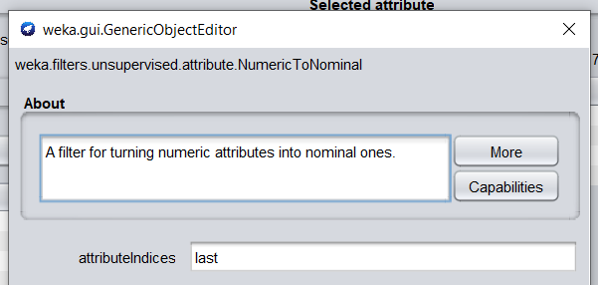
Data preprocessing
NumericToNominal for attribute DEATH_EVENT

Slide 4
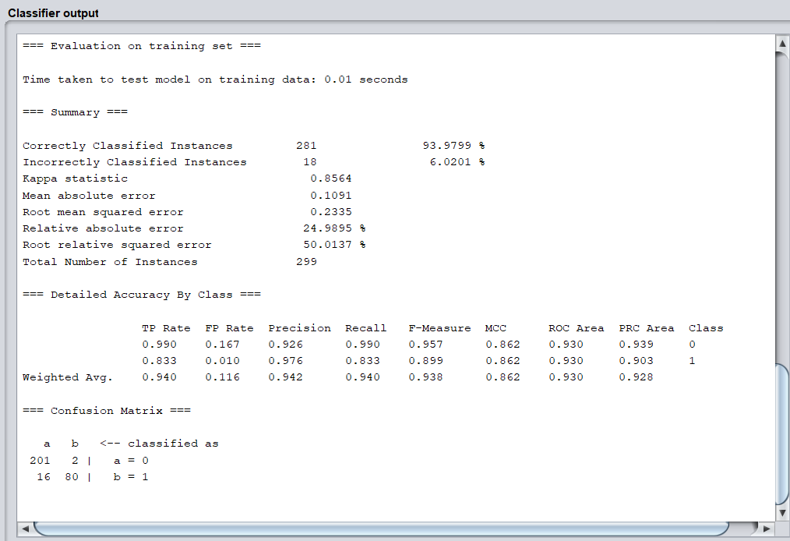
trees.J48 Classifier output

Slide 5
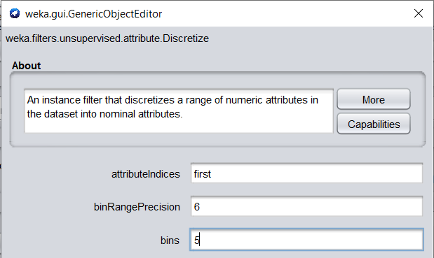
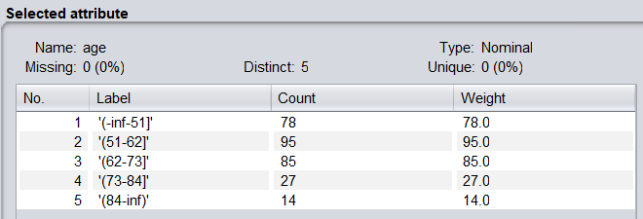
Data preprocessing
Discretize age in 5,10,15 bins

Slide 6
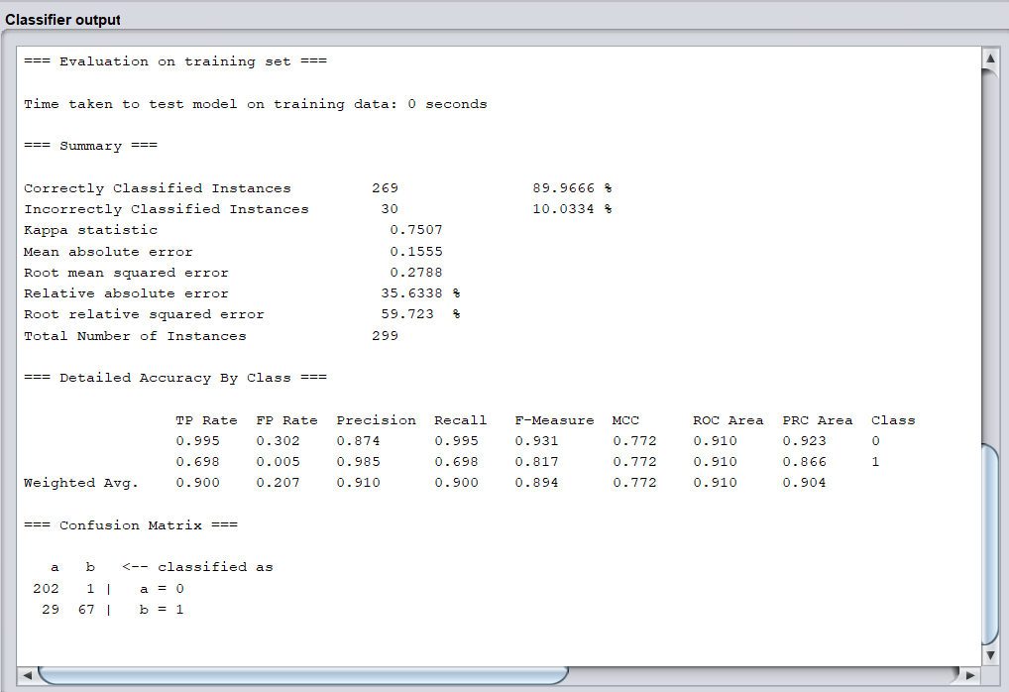
trees.J48 Classifier output
Age 10 bins

Slide 7
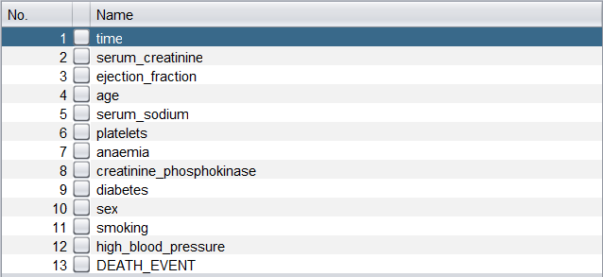
Select features with Weka Attribute Selector

Slide 8
Select features with Weka Attribute Selector

Slide 9
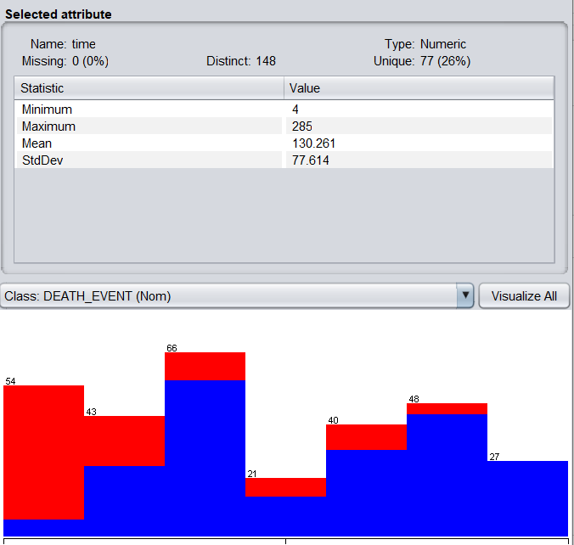

Slide 10
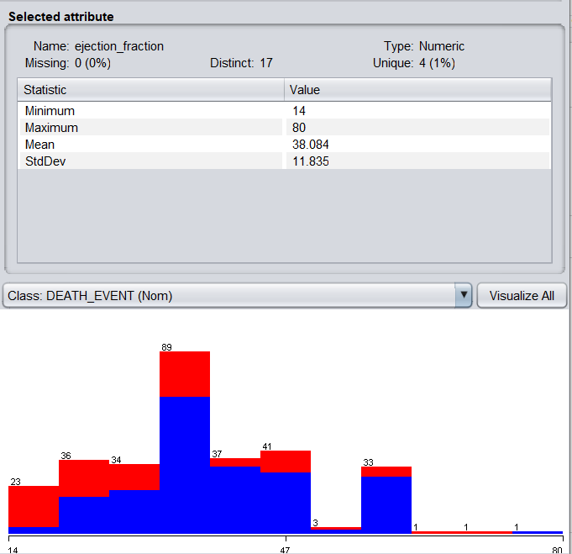

Slide 11
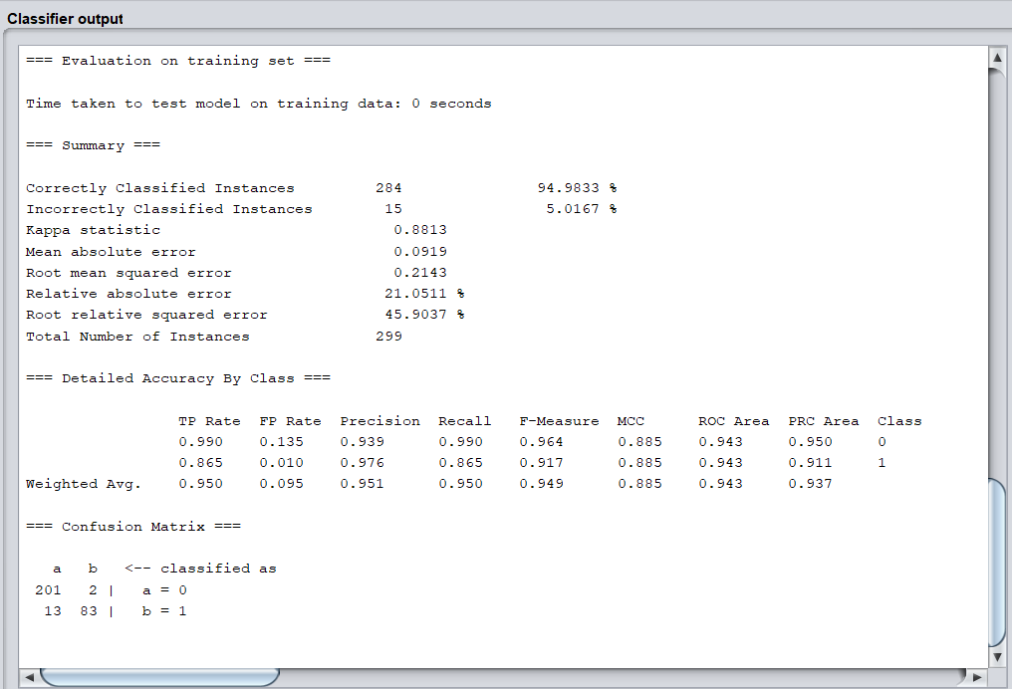
trees.J48 Classifier output
Best result

Slide 12
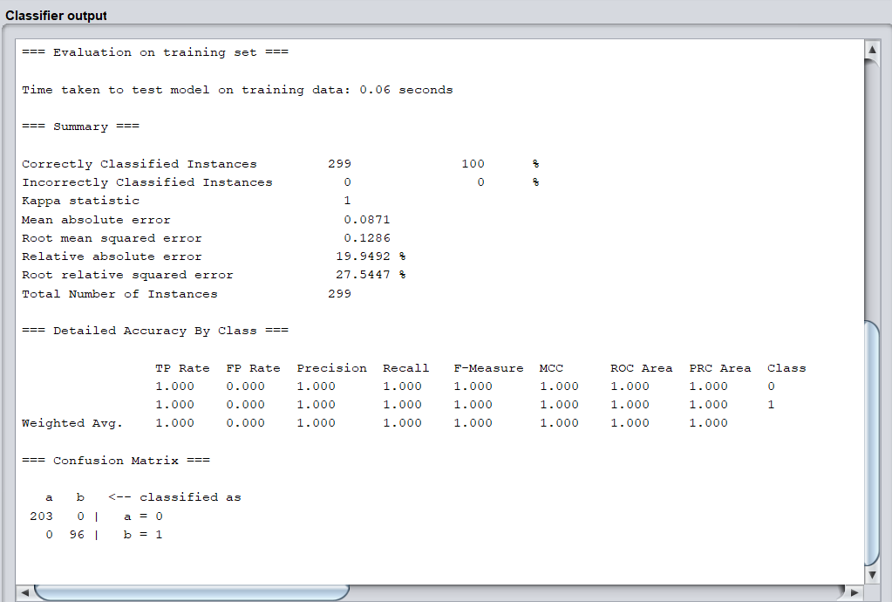
Random Forest Classifier output

Slide 13
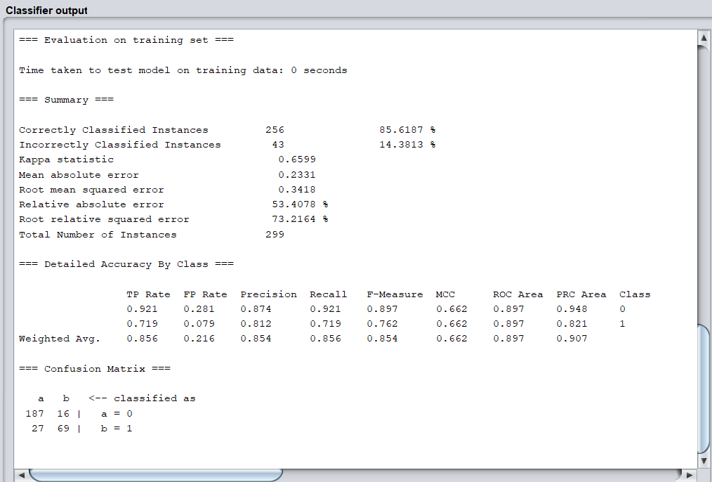
Logistic Classifier output

Slide 14
Car Price Prediction
Dataset: https://www.kaggle.com/nehalbirla/vehicle-dataset-from-cardekho

Slide 15
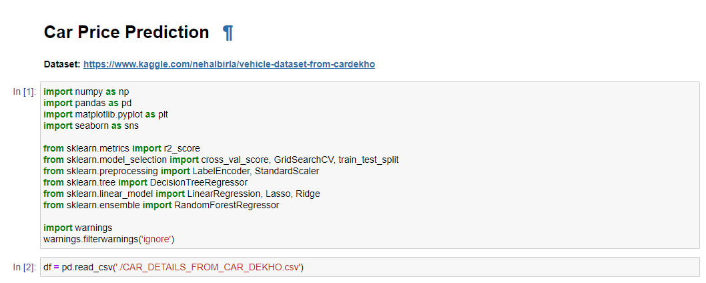

Slide 16
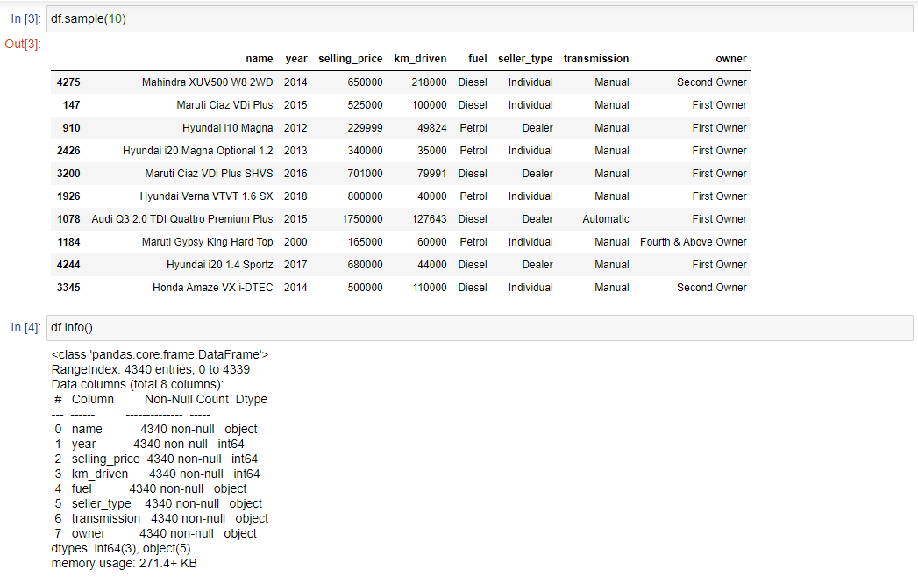

Slide 17
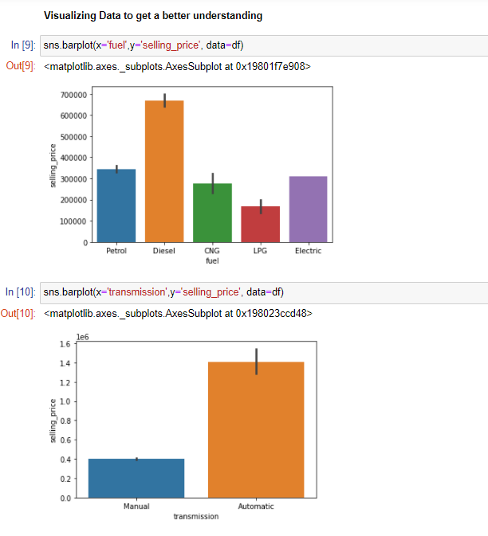
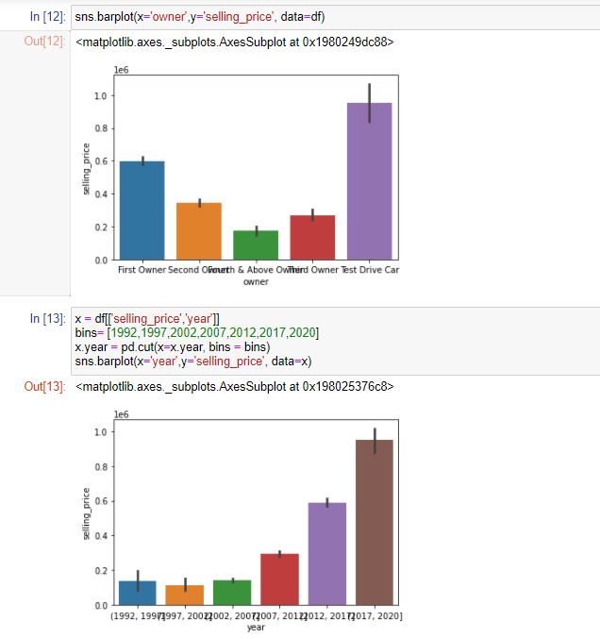

Slide 18
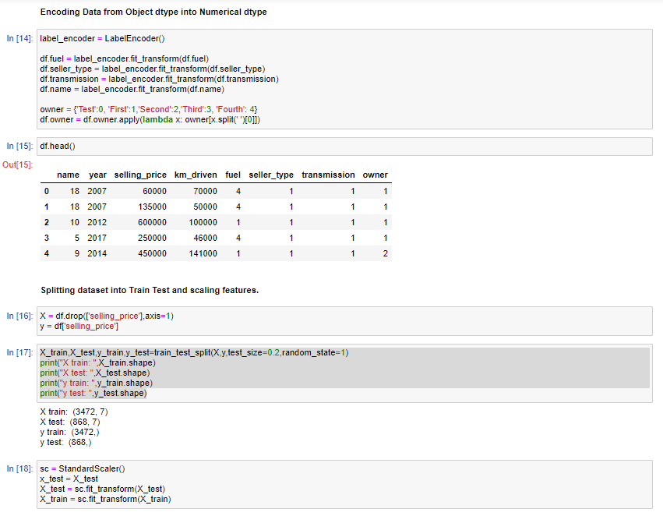

Slide 19
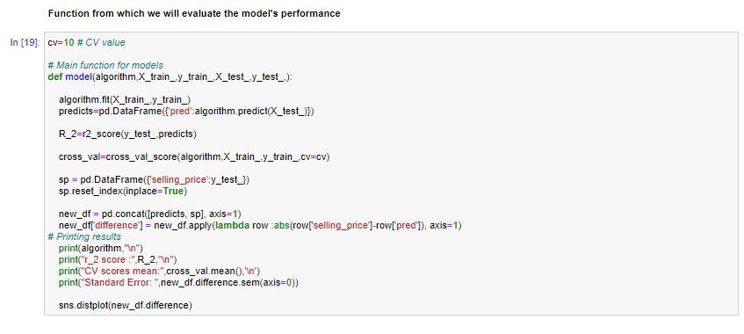

Slide 20
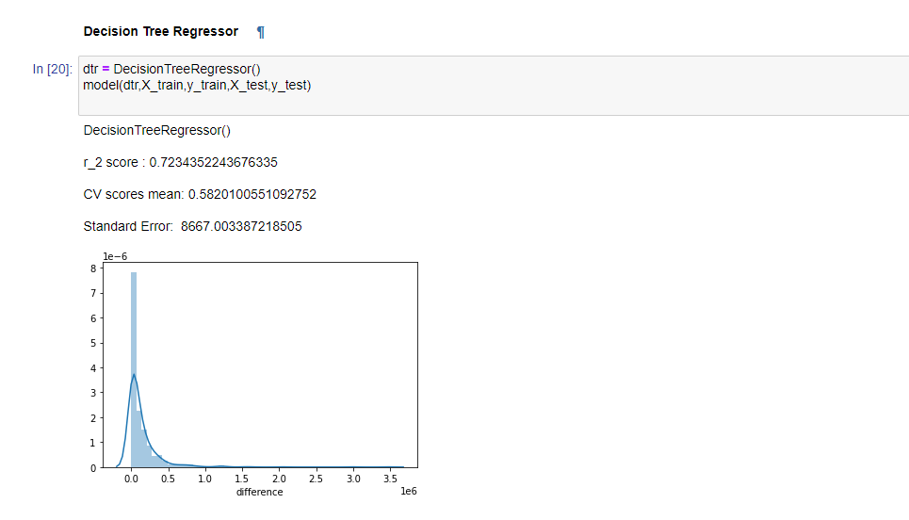
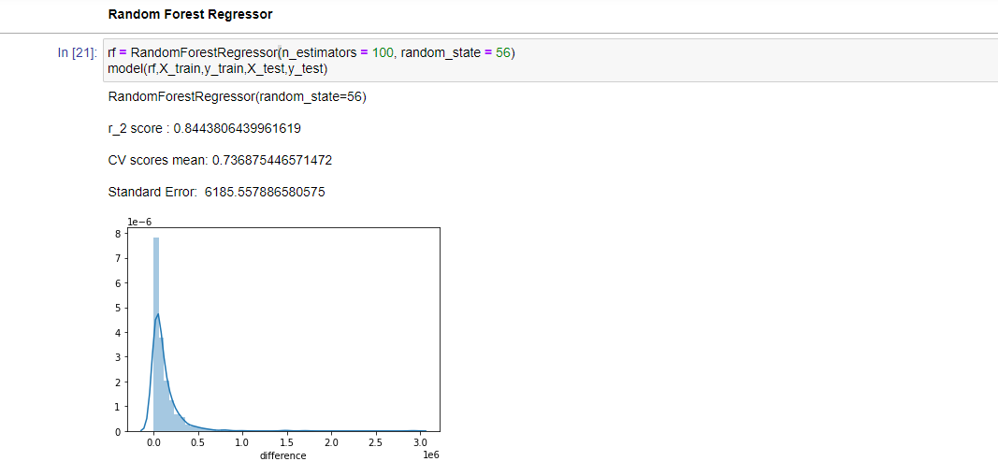

Slide 21
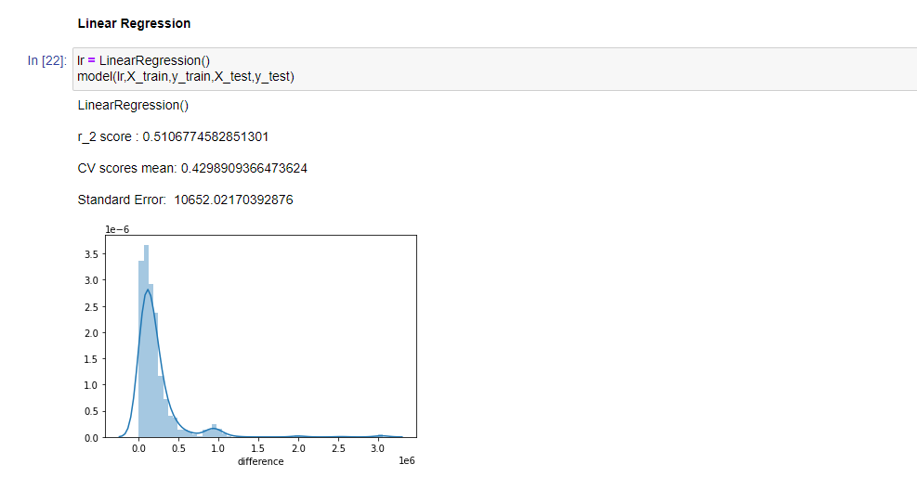

Slide 22
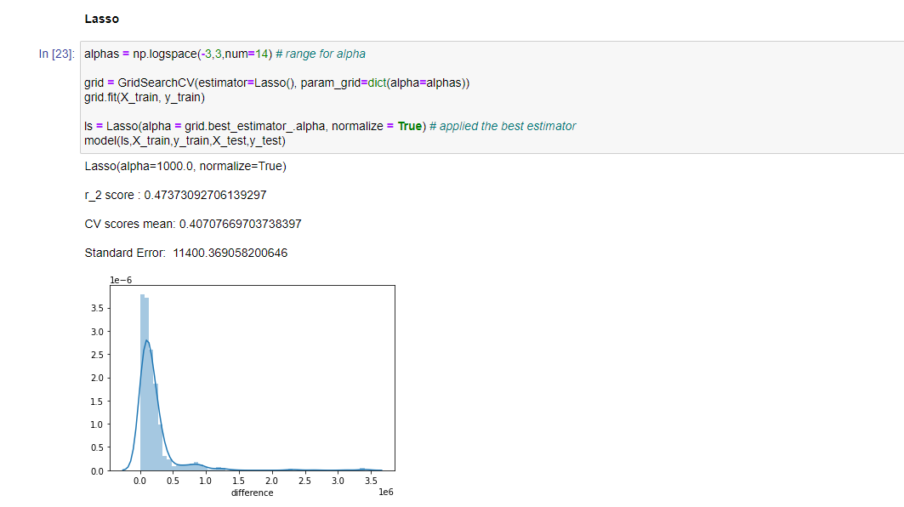
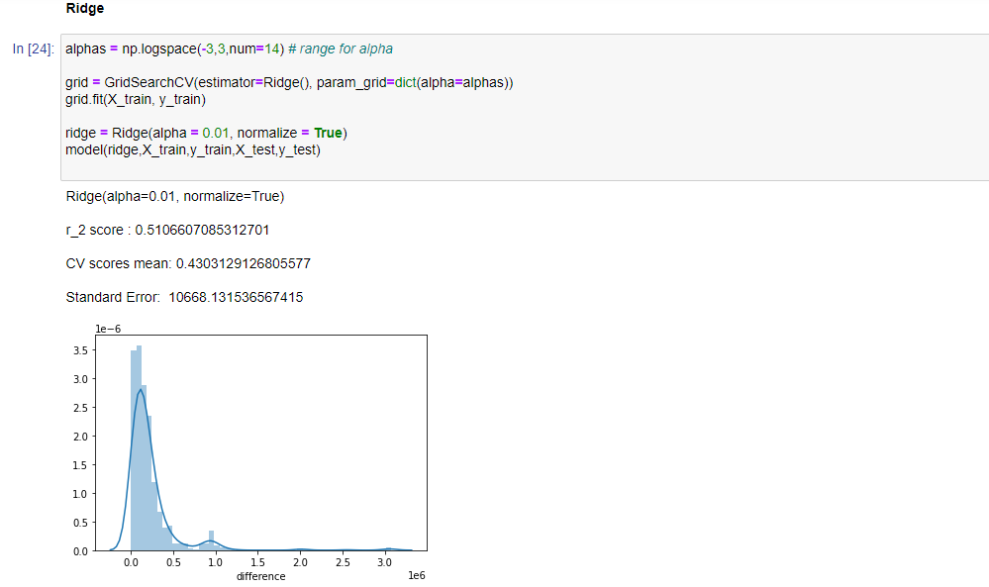

Slide 23
Heart Disease Prediction
Dataset: https://www.kaggle.com/ronitf/heart-disease-uci

Slide 24
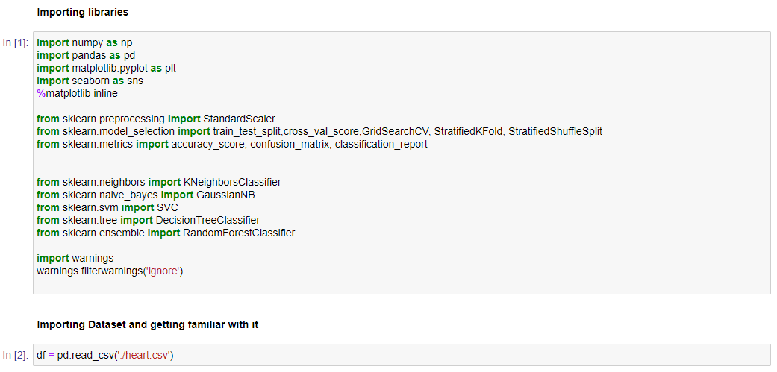

Slide 25
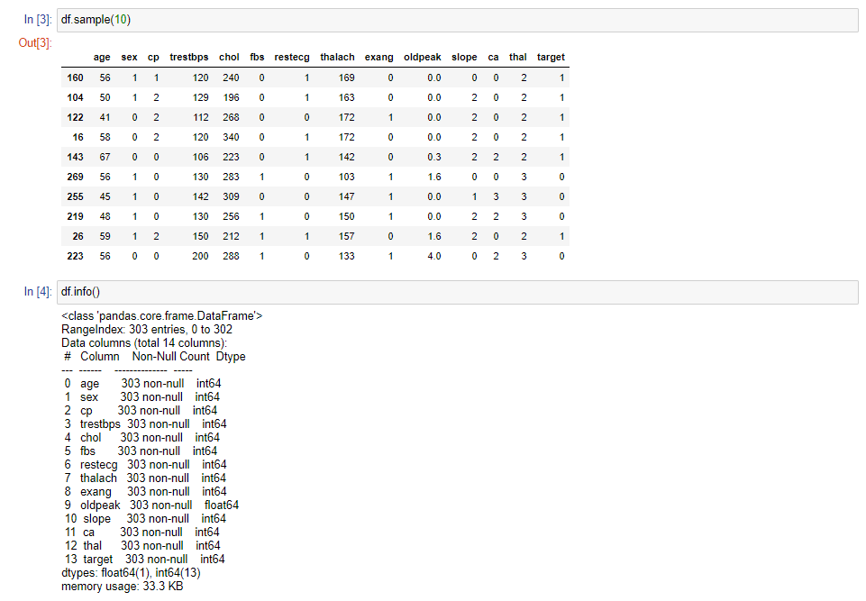
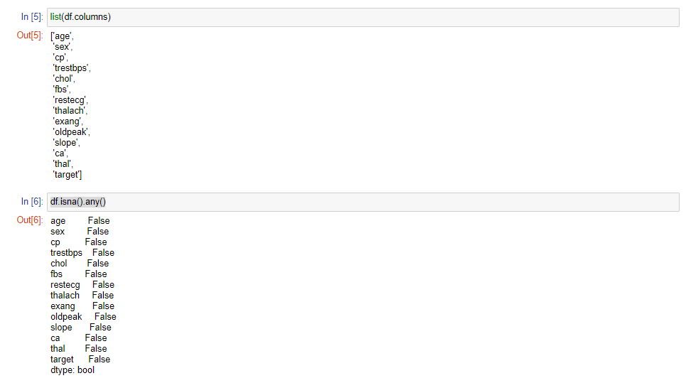

Slide 26
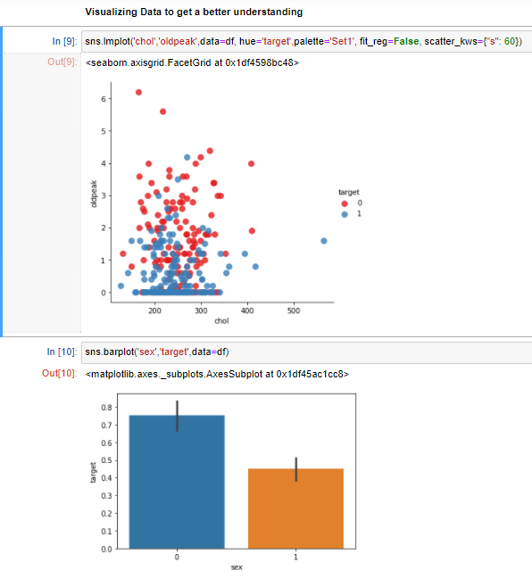
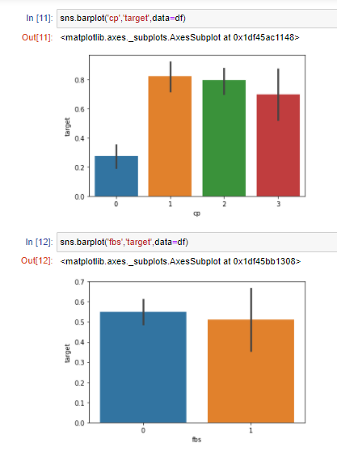

Slide 27
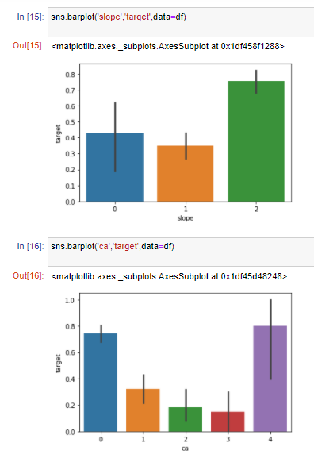
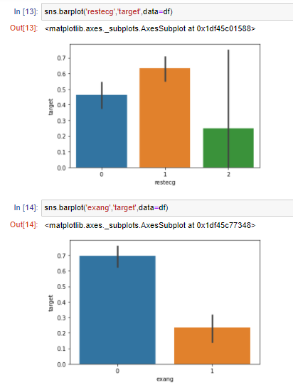

Slide 28
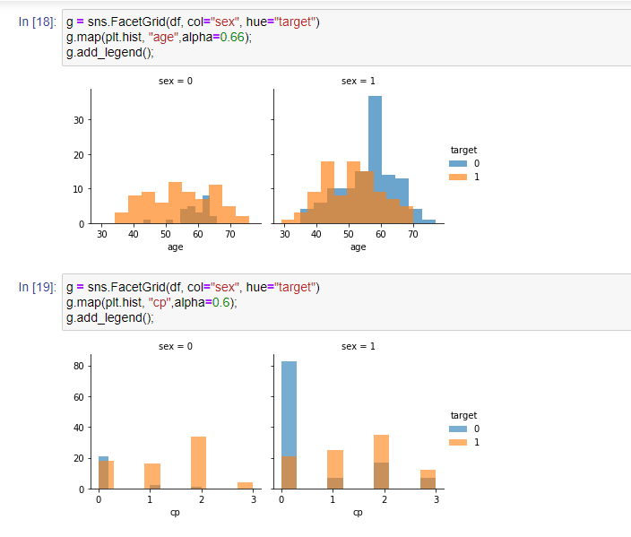
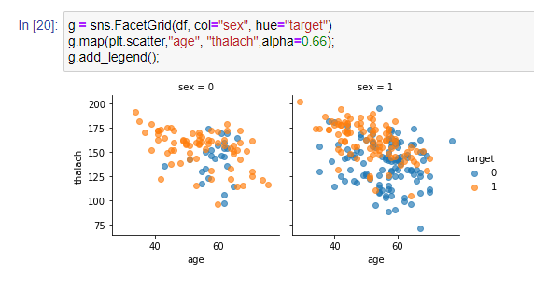

Slide 29
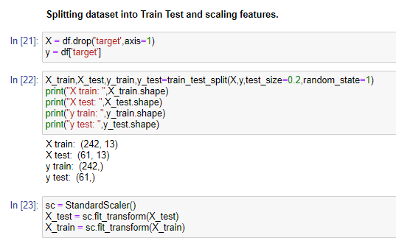

Slide 30
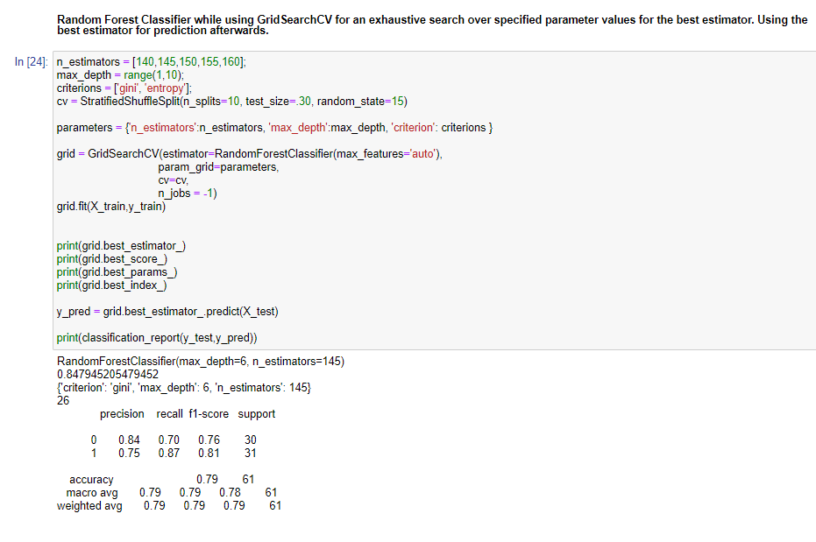

Slide 31
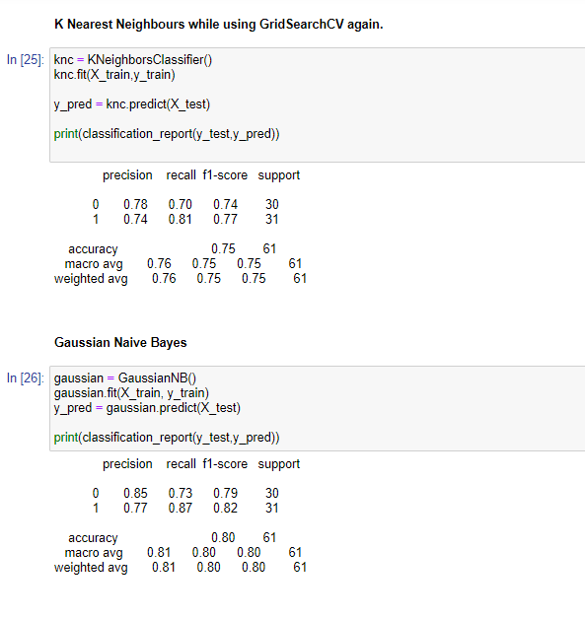
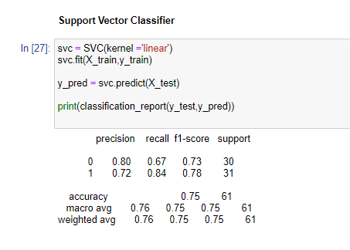

Slide 32
Job Posting Authenticity
Dataset: https://www.kaggle.com/shivamb/real-or-fake-fake-jobposting-prediction
Number of features: 18
Number of instances: 17880

Slide 33
Feature Descriptions
Key Feature Descriptiom:
department (string) - Corporate department (e.g. sales).
fraudility (boolean) - Posting is genuine or fake
company_profile (string) – A brief company description
description (string) – Job Description
requirements (string) – Listed Requirements
telecommuting (boolean) - True for telecommuting positions.
has_company_logo (boolean) – True if company logo is present
has_questions (boolean) – True if screening questions are present
employment_type (string) - Full-type, Part-time, Contract, etc.
required_experience (string) - Executive, Entry level, Intern, etc.
industry (string) - Automotive, IT, Health care, Real estate, etc.

Slide 34
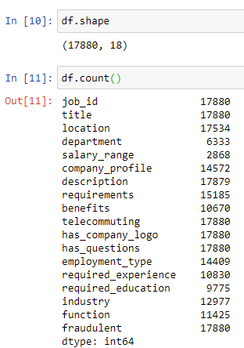
Exploring dataset

Slide 35
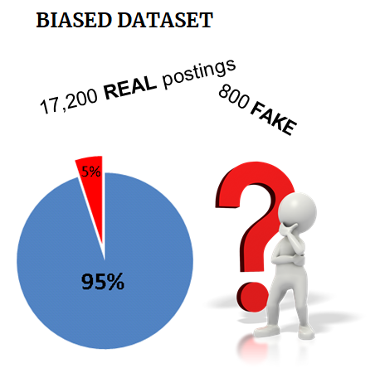
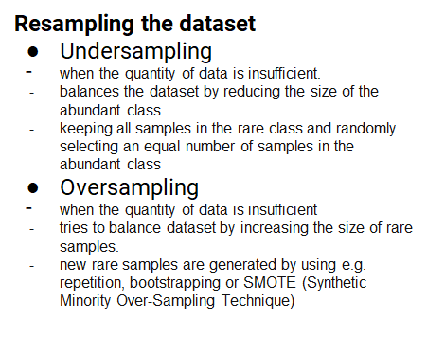
Challenge

Slide 36
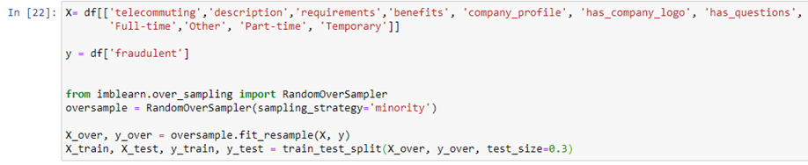
Oversampling implementation

Slide 37
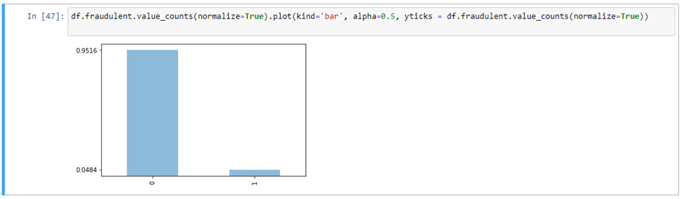
Observation of imbalanced data

Slide 38
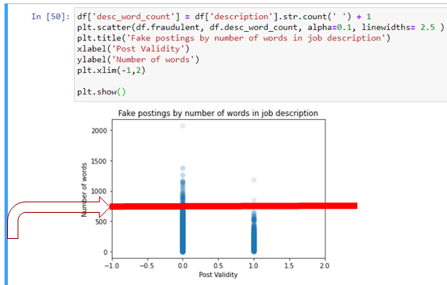
Fake job postings are more likely to have less words in the job description.. right?
The number of fraudulent job postings experiences a steep decrease in cases where the number of words in the job description is higher than
750.

Slide 39
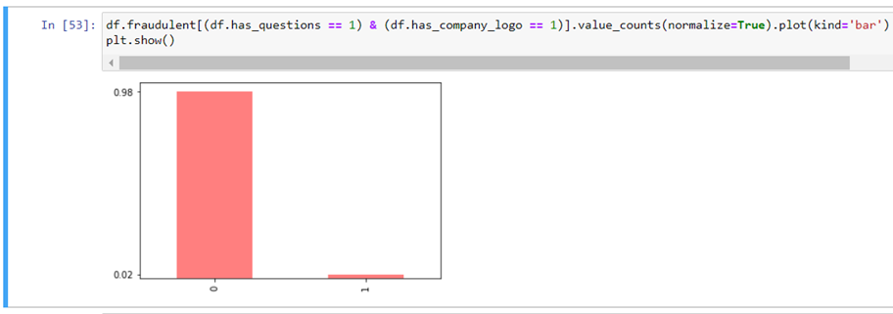
Real companies are more likely to have questions for you and a company logo.

Slide 40
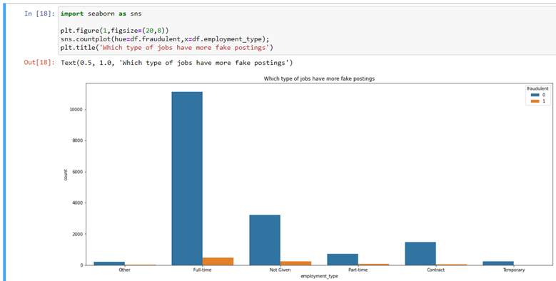
Postings grouped by employment type.

Slide 41
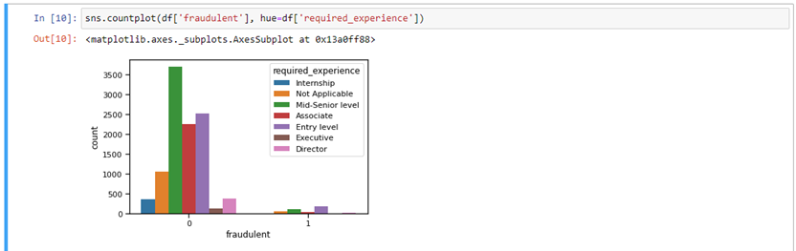
The trend based on required_experience feature.

Slide 42
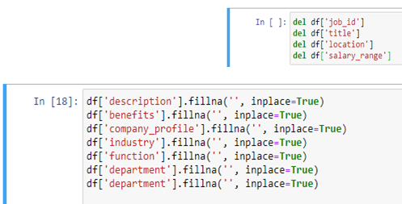
Data Preprocessing
Deletion of unnecessary features and filling missing data.

Slide 43
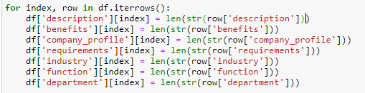
Data Preprocessing
Replace text fields with the length of the text for each of the following columns.

Slide 44
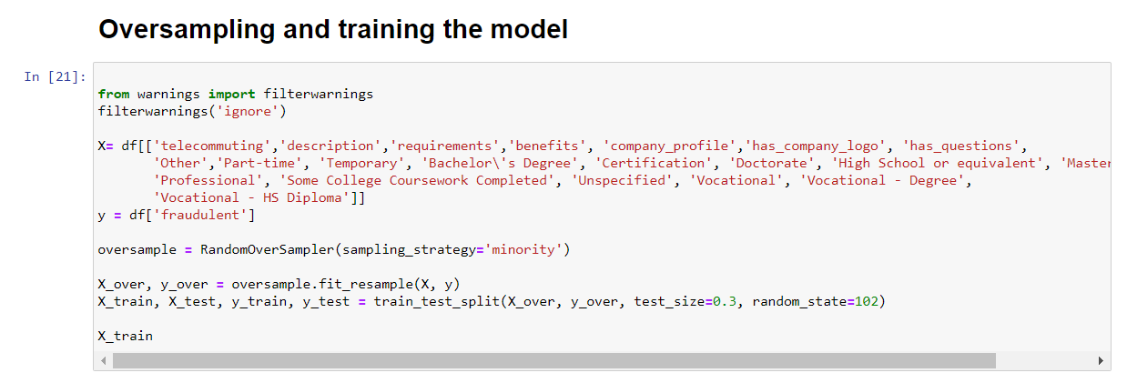

Slide 45
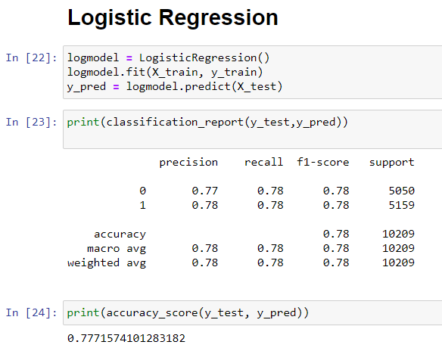
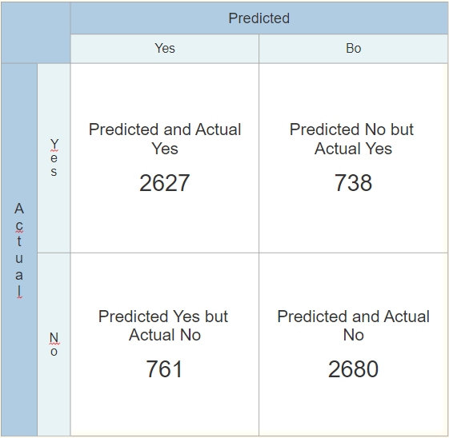
Predicting and results

Slide 46
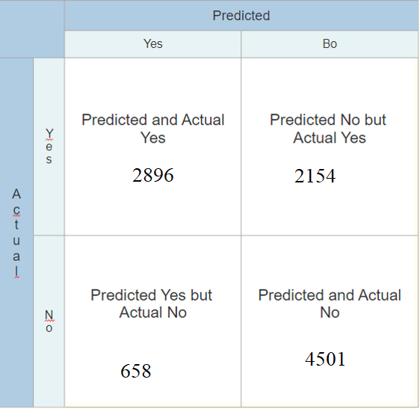

Predicting and results

Slide 47


Predicting and results

Slide 48


Predicting and results

